Slide 1
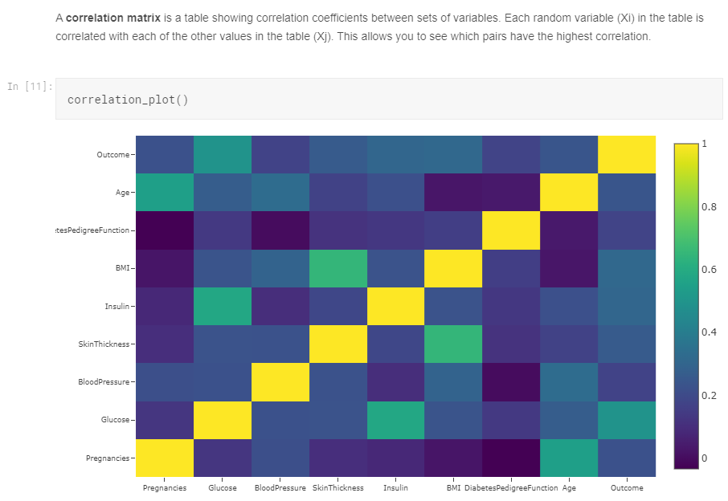

Slide 2
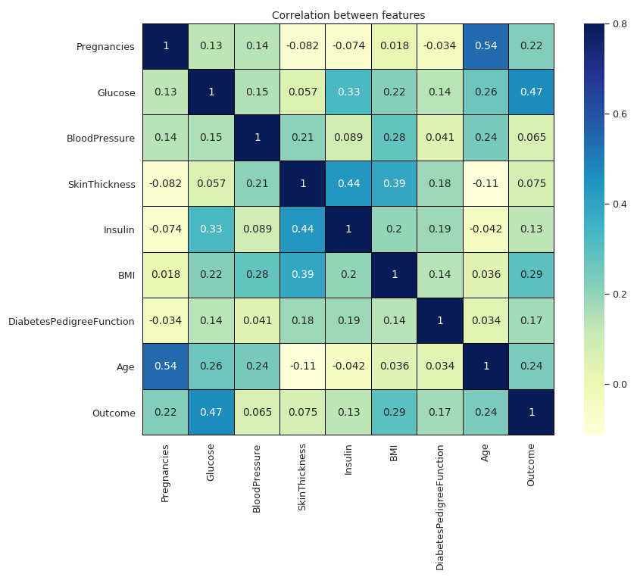
# Correlation between features
Variables within a dataset can be related for lots of reasons. It can be useful in data analysis and modelling to better understand the relationships between variables. The statistical relationship between two variables is referred to as their correlation.
A correlation could be positive, meaning both variables move in the same direction, or negative, meaning that when one variable’s value increases, the other variables’ values decrease. Correlation can also be neural or zero, meaning that the variables are unrelated.

Slide 3
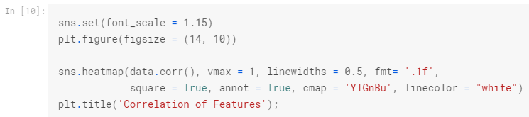
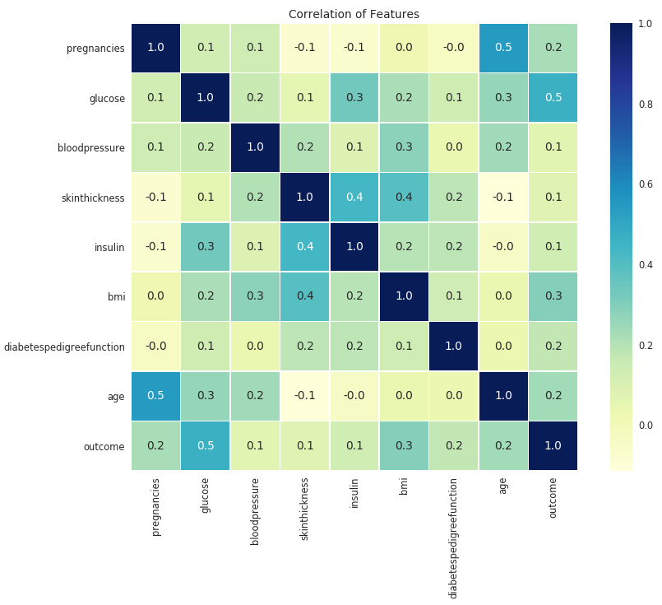

Slide 4
